Slide 1
L10 Cache Optimizations
Zonghua Gu, 2018
5/4/2018
Acknowledgement: some slides taken from UC Berkeley CS61C

Slide 2
Optimizations for the Memory Hierarchy
Write code that has locality!
Spatial: access data contiguously
Temporal: make sure access to the same data is not too far apart in time
How can you achieve locality?
Adjust memory accesses in code (software) to improve miss rate (MR)
Requires knowledge of both how caches work as well as your system’s parameters
Proper choice of algorithm
Loop transformations

Slide 3
Example: Matrix Sum
Consider the following two loops, which calculate the sum of the entries in a 3x4 matrix A of 32-bit integers:
Loop A | Loop B
sum = 0; for (i = 0; i < 3; i++) for (j = 0; j < 4; j++) sum += A[i][j]; | sum = 0; for (j = 0; j < 4; j++) for (i = 0; i < 3; i++) sum += A[i][j];
Matrix A is stored contiguously in memory in row-major order. Row major order means that elements in the same row of the matrix are adjacent in memory (A[i][j] resides in memory location [4*(64*i + j)]).
Layout in Memory
a [0] [0] | a [0] [1] | a [0] [2] | a [0] [3] | a [1] [0] | a [1] [1] | a [1] [2] | a [1] [3] | a [2] [0] | a [2] [1] | a [2] [2] | a [2] [3]
76
92
108
Note: 76 is just one possible starting address of A

Slide 4
Matrix Sum Loop A
j
Loop A
sum = 0; for (i = 0; i < 3; i++) for (j = 0; j < 4; j++) sum += A[i][j];
a[0][0] |  | a[0][1] |  | a[0][2] |  | a[0][3]
a[1][0] |  | a[1][1] |  | a[1][2] |  | a[1][3]
a[2][0] |  | a[2][1] |  | a[2][2] |  | a[2][3]
Index j is incremented in the inner loop
Good spatial locality for a[][]
No temporal locality for a[][]
Each element is used only once
i
Access Pattern:
stride = 1
1) | a[0][0]
2) | a[0][1]
3) | a[0][2]
4) | a[0][3]
5) | a[1][0]
6) | a[1][1]
7) | a[1][2]
8) | a[1][3]
9) | a[2][0]
10) | a[2][1]
11) | a[2][2]
12) | a[2][3]
Layout in Memory
a [0] [0] | a [0] [1] | a [0] [2] | a [0] [3] | a [1] [0] | a [1] [1] | a [1] [2] | a [1] [3] | a [2] [0] | a [2] [1] | a [2] [2] | a [2] [3]

Slide 5
Matrix Sum Loop B
j
Loop B
sum = 0; for (j = 0; j < 4; j++) for (i = 0; i < 3; i++) sum += A[i][j];
a[0][0] |  | a[0][1] |  | a[0][2] |  | a[0][3]
a[1][0] |  | a[1][1] |  | a[1][2] |  | a[1][3]
a[2][0] |  | a[2][1] |  | a[2][2] |  | a[2][3]
Index i is incremented in the inner loop
Poor spatial locality for a[][]
No temporal locality for a[][]
Each element is used only once
i
Access Pattern:
stride = 4
1) | a[0][0]
2) | a[1][0]
3) | a[2][0]
4) | a[0][1]
5) | a[1][1]
6) | a[2][1]
7) | a[0][2]
8) | a[1][2]
9) | a[2][2]
10) | a[0][3]
11) | a[1][3]
12) | a[2][3]
Layout in Memory
a [0] [0] | a [0] [1] | a [0] [2] | a [0] [3] | a [1] [0] | a [1] [1] | a [1] [2] | a [1] [3] | a [2] [0] | a [2] [1] | a [2] [2] | a [2] [3]

Slide 6
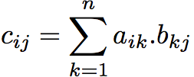
Example: Matrix Multiplication
C
A
B
c_{ij}
=
×
a_{i*}
b_{*j}
The mathematical cache miss analysis in this example will not be covered in the exam. You only need to grasp the basic concept of cache blocking.
Notes:
Subscript indices given in (row,col).

Slide 7



Naïve Matrix Multiply
# move along rows of A
for (i = 0; i < n; i++)
# move along columns of B
for (j = 0; j < n; j++)
# EACH k loop reads row of A, col of B
# Also read & write c(i,j) n times
for (k = 0; k < n; k++)
C[i][j] += A[i][k] * B[k][j];
//Equivalent form
//C[i*n+j] += A[i*n+k] * B[k*n+j];
C(i,j)
C(i,j)
A(i,:)
$$=$$
$$+$$
$$×$$
B(:,j)
Notes:
Note the += leads to an additional read of matrix C
Read A
Read B
Read C
Write C (guaranteed hit due to read of C)

Slide 8

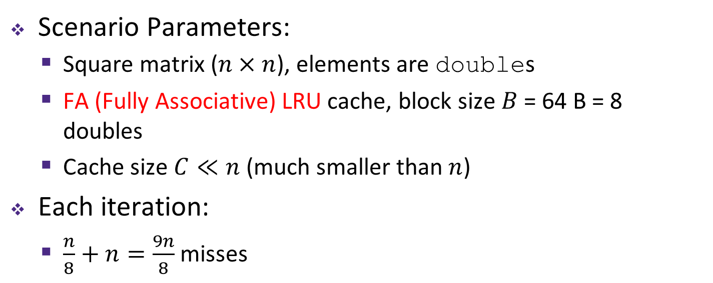

Cache Miss Analysis (Naïve)
Ignoring
matrix c
Scenario Parameters:
Square matrix ($n×n$), elements are doubles
FA (Fully Associative) LRU cache, block size $B$ = 64 B = 8 doubles
Cache size $C≪n$ (much smaller than $n$)
Each iteration:
$\frac{n}{8}+n=\frac{9n}{8}$ misses
$$=$$
$$×$$
Each cache block holds 8 elements
Reading one row of Matrix A
good spatial locality with stride 1
1 cache miss every 8 elements; total cache misses due to reading one row of A is n/8
Reading one column of Matrix B
poor spatial locality with stride n
1 cache miss every element; total cache misses due to reading one column of B is n
Notes:
Each cache block holds 8 matrix elements
A has good spatial locality
Stride 1
B has poor spatial locality
Stride n
By the time element n+1 is accessed, block has been kicked out of $
Iteration:
A = n/8
B = n

Slide 9




$$×$$
$$×$$
1st cache miss brings 8 elements A[0][0], A[0][1] … A[0][7] into cache
2nd cache miss brings 8 elements B[0][0], B[0][1]… B[0][7] into cache
Compute A[0][0]*B[0][0]; Only B[0][0] is used
3rd cache miss brings 8 elements B[1][0], B[1][1] … B[1][7] into cache
Compute A[0][1]*B[1][0]
Only B[1][0] is used
…
$$×$$
$$×$$
4th cache miss brings 8 elements B[2][0], B[2][1] … B[2][7] into cache
Compute A[0][2]*B[2][0]
Only B[2][0] is used
9th cache miss brings 8 elements A[0][8], A[0][9] … A[0][15] into cache
10th cache miss brings 8 elements B[8][0], B[8][1] … B[8][7] into cache
Compute A[0][8]*B[8][0]
Notes:
(n+1)^{th} cache miss brings 8 elements B[n-1][0], B[n-1][1] … B[n-1][7] into cache
Compute A[1][0]*B[0][0] (by the time B

Slide 10


$$×$$
$$×$$
At the end of multiplying 0th row of A[0][0…n-1] with 0th column of B[0…n-1][0], this is what the cache contains (assuming cache is quite small compared to matrix size)
By the time we get to 1st row of A[1][0…n-1], the top left elements of B have been evicted from the cache, so every element of B has to be fetched again from memory, even though they have been used before. So the process repeats.

Slide 11

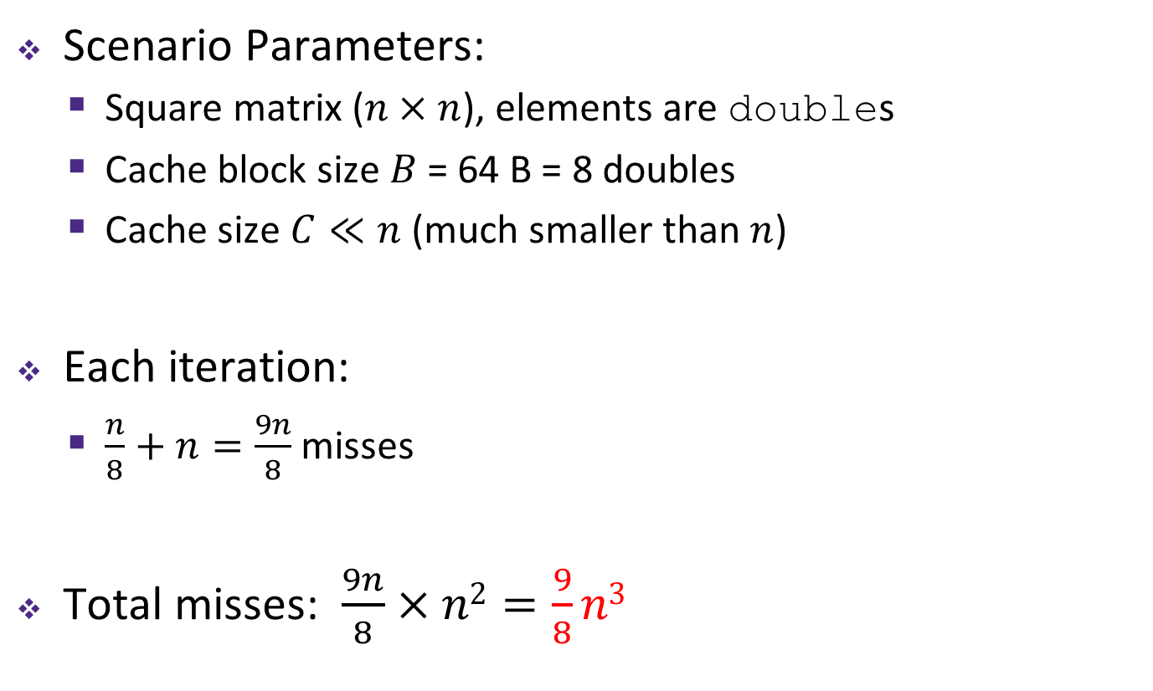

Cache Miss Analysis (Naïve)
Ignoring
matrix c
Scenario Parameters:
Square matrix ($n×n$), elements are doubles
Cache block size $B$ = 64 B = 8 doubles
Cache size $C≪n$ (much smaller than $n$)
Each iteration:
$\frac{n}{8}+n=\frac{9n}{8}$ misses
Total misses: $\frac{9n}{8}×n2=\frac{9}{8}n3$
$$=$$
$$×$$
n iterations of the doubly-nested loop

Slide 12
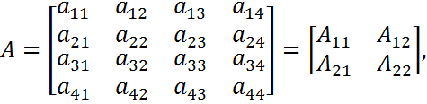


Cache Blocking (1)
Can get the same result of a matrix multiplication by splitting the matrices into smaller submatrices (matrix “blocks”)
For example, multiply two 4×4 matrices:

Slide 13
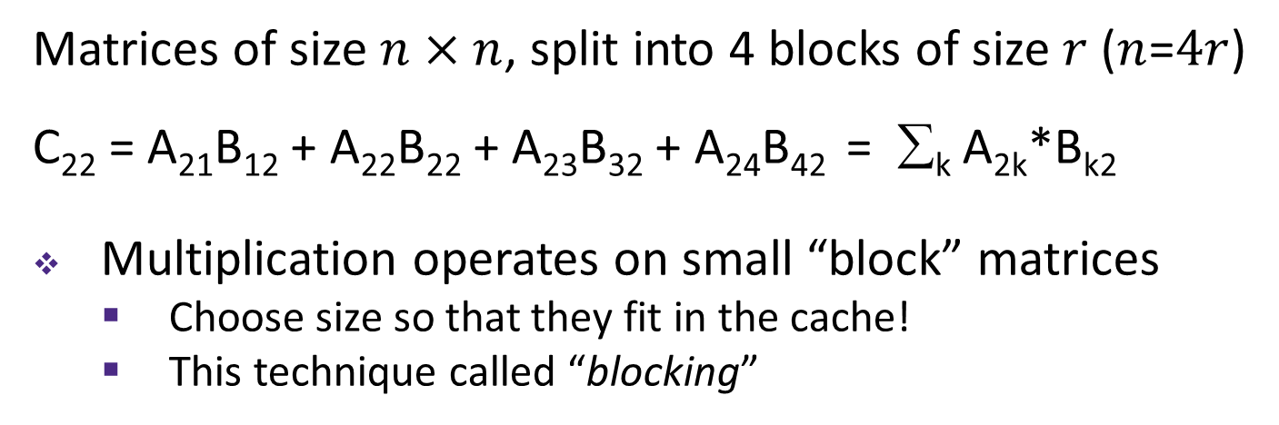
Cache Blocking (2)
C₁₁
C₁₂
C₁₃
C₁₄
A₁₁
A₁₂
A₁₃
A₁₄
B₁₁
B₁₂
B₁₃
B₁₄
C₂₁
C₂₂
C₂₃
C₂₄
A₂₁
A₂₂
A₂₃
A₂₄
B₂₁
B₂₂
B₂₃
B₂₄
C₃₁
C₃₂
C₄₃
C₃₄
A₃₁
A₃₂
A₃₃
A₃₄
B₃₂
B₃₂
B₃₃
B₃₄
C₄₁
C₄₂
C₄₃
C₄₄
A₄₁
A₄₂
A₄₃
A₁₄₄
B₄₁
B₄₂
B₄₃
B₄₄
Matrices of size $n×n$, split into 4 blocks of size $r$ ($n$=$4r$)
C₂₂ = A₂₁B₁₂ + A₂₂B₂₂ + A₂₃B₃₂ + A₂₄B₄₂ = ∑_{k} A_{2k}*B_{k2}
Multiplication operates on small “block” matrices
Choose size so that they fit in the cache!
This technique called “blocking”

Slide 14
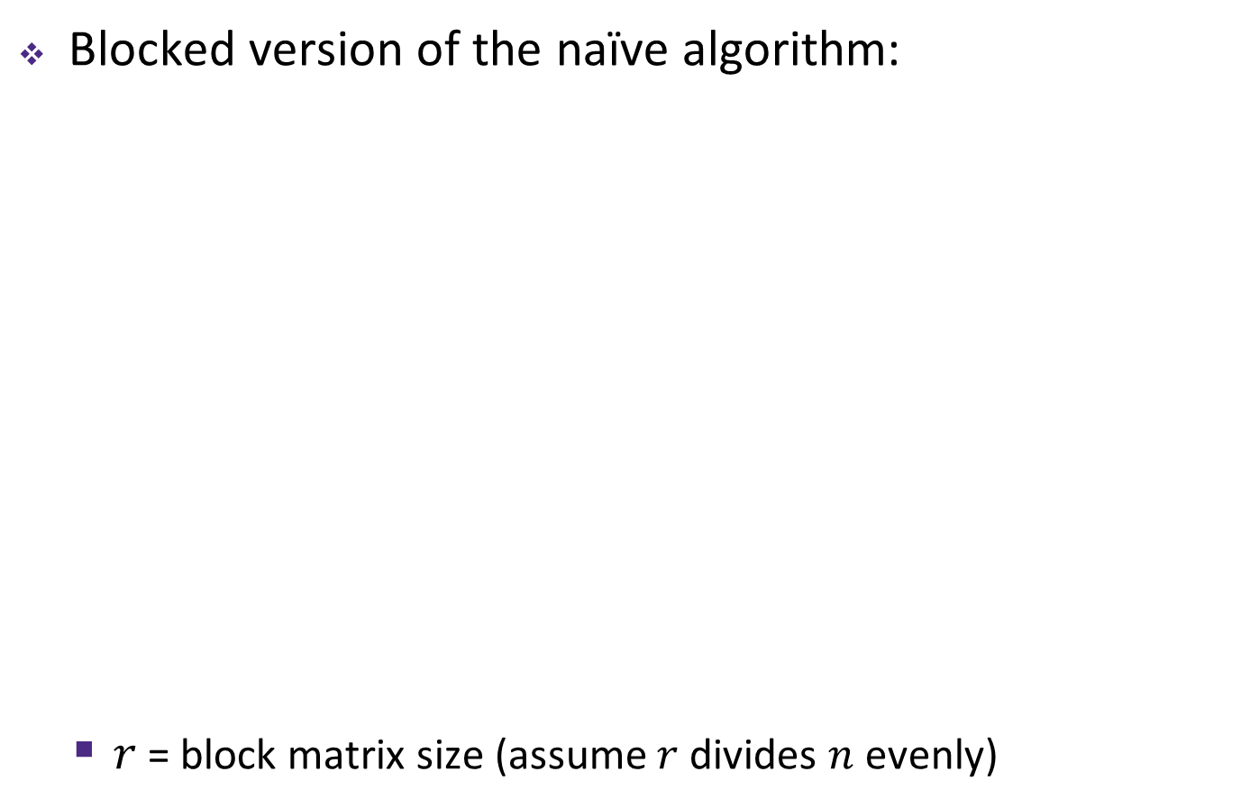
Blocked Matrix Multiply
Blocked version of the naïve algorithm:
$r$ = block matrix size (assume $r$ divides $n$ evenly)
# move by rxr BLOCKS now
for (i = 0; i < n; i += r)
for (j = 0; j < n; j += r)
for (k = 0; k < n; k += r)
# block matrix multiplication
for (ib = i; ib < i+r; ib++)
for (jb = j; jb < j+r; jb++)
for (kb = k; kb < k+r; kb++)
c[ib][jb] += a[ib][kb]*b[kb][jb];
//Equivalently
//c[ib*n+jb] += a[ib*n+kb]*b[kb*n+jb];
Notes:
6 nested loops seems inefficient, but leads to faster code!
Outer three loops: loop over block matrices
Inner three loops: loop within block matrices

Slide 15



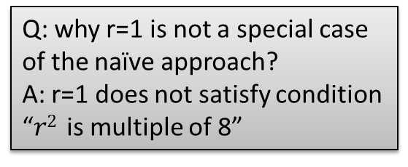
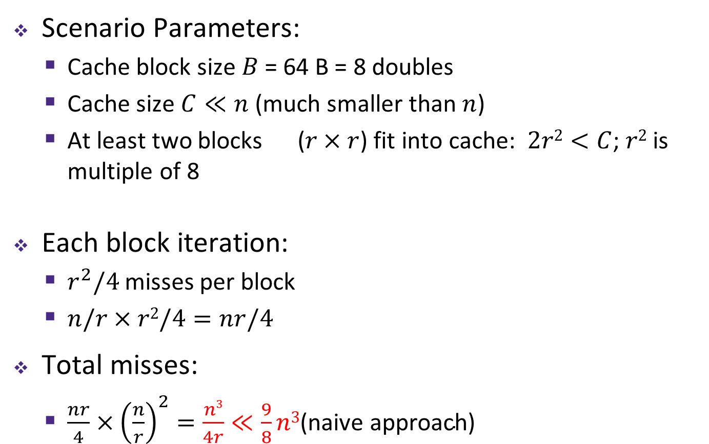
Cache Miss Analysis (Blocked)
Ignoring
matrix c
Scenario Parameters:
Cache block size $B$ = 64 B = 8 doubles
Cache size $C≪n$ (much smaller than $n$)
At least two blocks ($r×r$) fit into cache: $2r2<C$; $r2$ is multiple of 8
Each block iteration:
$r^{2}/4$ misses per block
$n/r×r2/4=nr/4$
Total misses:
$\frac{nr}{4}×{\left(\frac{n}{r}\right)}^{2}=\frac{n3}{4r}≪\frac{9}{8}n3\text{(}\text{naive} \text{approach}\text{)}$
$n$/$r$ blocks
$r2$ elements per block, 8 misses per cache block for each $r×r$block of A or B
$$=$$
$$×$$
Q: why r=1 is not a special case of the naïve approach?
A: r=1 does not satisfy condition “$r2$ is multiple of 8”
$n$/$r$ blocks in row and column
Notes:
3r² < C: need to be able to fit three full blocks in the cache (one for c, one for a, one for b) while executing the algorithm 𝑖𝑠 𝑚𝑢𝑙𝑡𝑖𝑝𝑙𝑒 𝑜𝑓 8

Slide 16


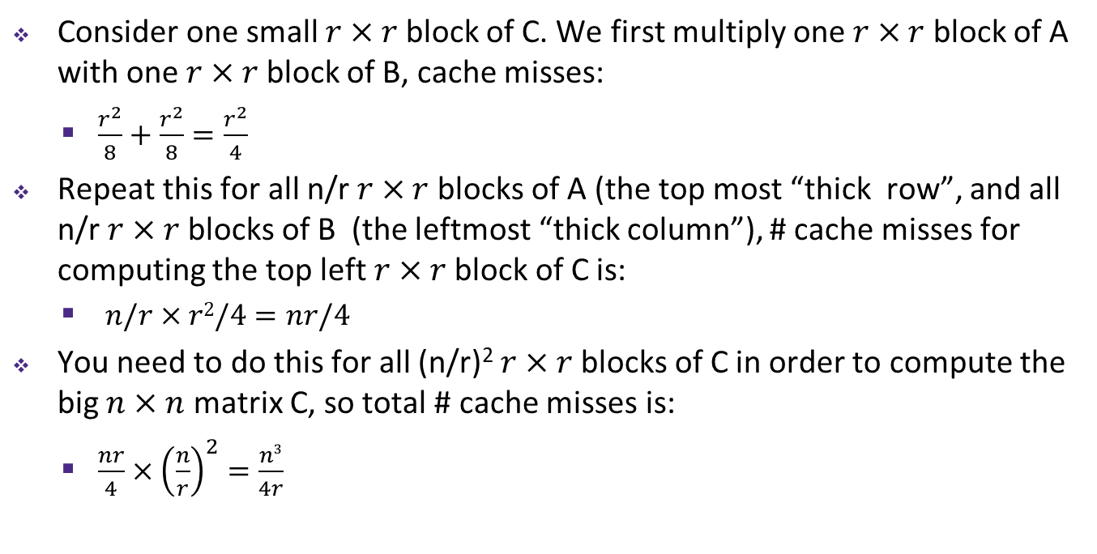

Detailed Cache Miss Analysis (Blocked)
Consider one small $r×r$block of C. We first multiply one $r×r$block of A with one $r×r$block of B, cache misses:
$\frac{r^{2}}{8}+\frac{r^{2}}{8}=\frac{r^{2}}{4}$
Repeat this for all n/r $r×r$blocks of A (the top most “thick row”, and all n/r $r×r$blocks of B (the leftmost “thick column”), # cache misses for computing the top left $r×r$block of C is:
$n/r×r2/4=nr/4$
You need to do this for all (n/r)² $r×r$blocks of C in order to compute the big $n×n$ matrix C, so total # cache misses is:
$\frac{nr}{4}×{\left(\frac{n}{r}\right)}^{2}=\frac{n3}{4r}$
$n$/$r$ blocks
$$=$$
$$×$$

Slide 17



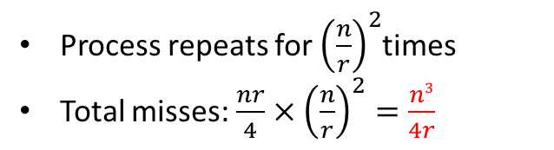
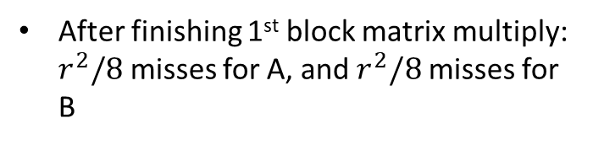

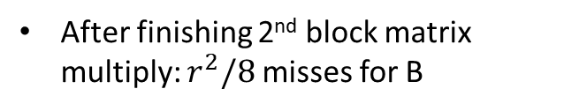
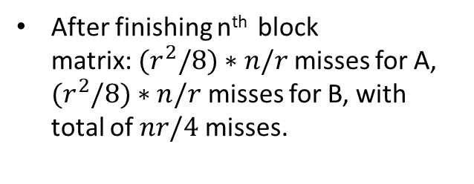
Cache Miss Analysis (Blocked)
$$×$$
$$×$$
After finishing 1st block matrix multiply: $r^{2}/8$ misses for A, and $r^{2}/8$ misses for B
After finishing 2nd block matrix multiply: $r^{2}/8$ misses for B
$$×$$
$$×$$
After finishing n^{th} block matrix:${(r}^{2}/8)∗n/r$ misses for A, ${(r}^{2}/8)∗n/r$ misses for B, with total of $nr/4$ misses.
Process repeats for ${\left(\frac{n}{r}\right)}^{2}$times
Total misses:$\frac{nr}{4}×{\left(\frac{n}{r}\right)}^{2}=\frac{n3}{4r}$

Slide 18
Cache-Friendly Code
Programmer can optimize for cache performance
How data structures are organized
How data are accessed
Nested loop structure
Blocking is a general technique
All systems favor “cache-friendly code”
Getting absolute optimum performance is very platform specific
Cache size, cache block size, associativity, etc.
Can get most of the advantage with generic code
Keep working set reasonably small (temporal locality)
Use small strides (spatial locality)
Focus on inner loop code
Notes:
Generic Code -> good rules of thumb

Slide 19
The Memory Mountain
Core i7 Haswell
2.1 GHz
32 KB L1 d-cache
256 KB L2 cache
8 MB L3 cache
64 B block size
Aggressive prefetching
L1
Ridges
of temporal locality
L2
L3
Slopes
of spatial locality
Mem
Notes:
Increase stride size = less spatial locality = drop in throughput
Increase working set size = less temporal locality = fall out of respective caches
All caches on-chip

